Slide 1

AI Trader's Edge Playbook
Sean Wong
2025/08/05

Slide 2
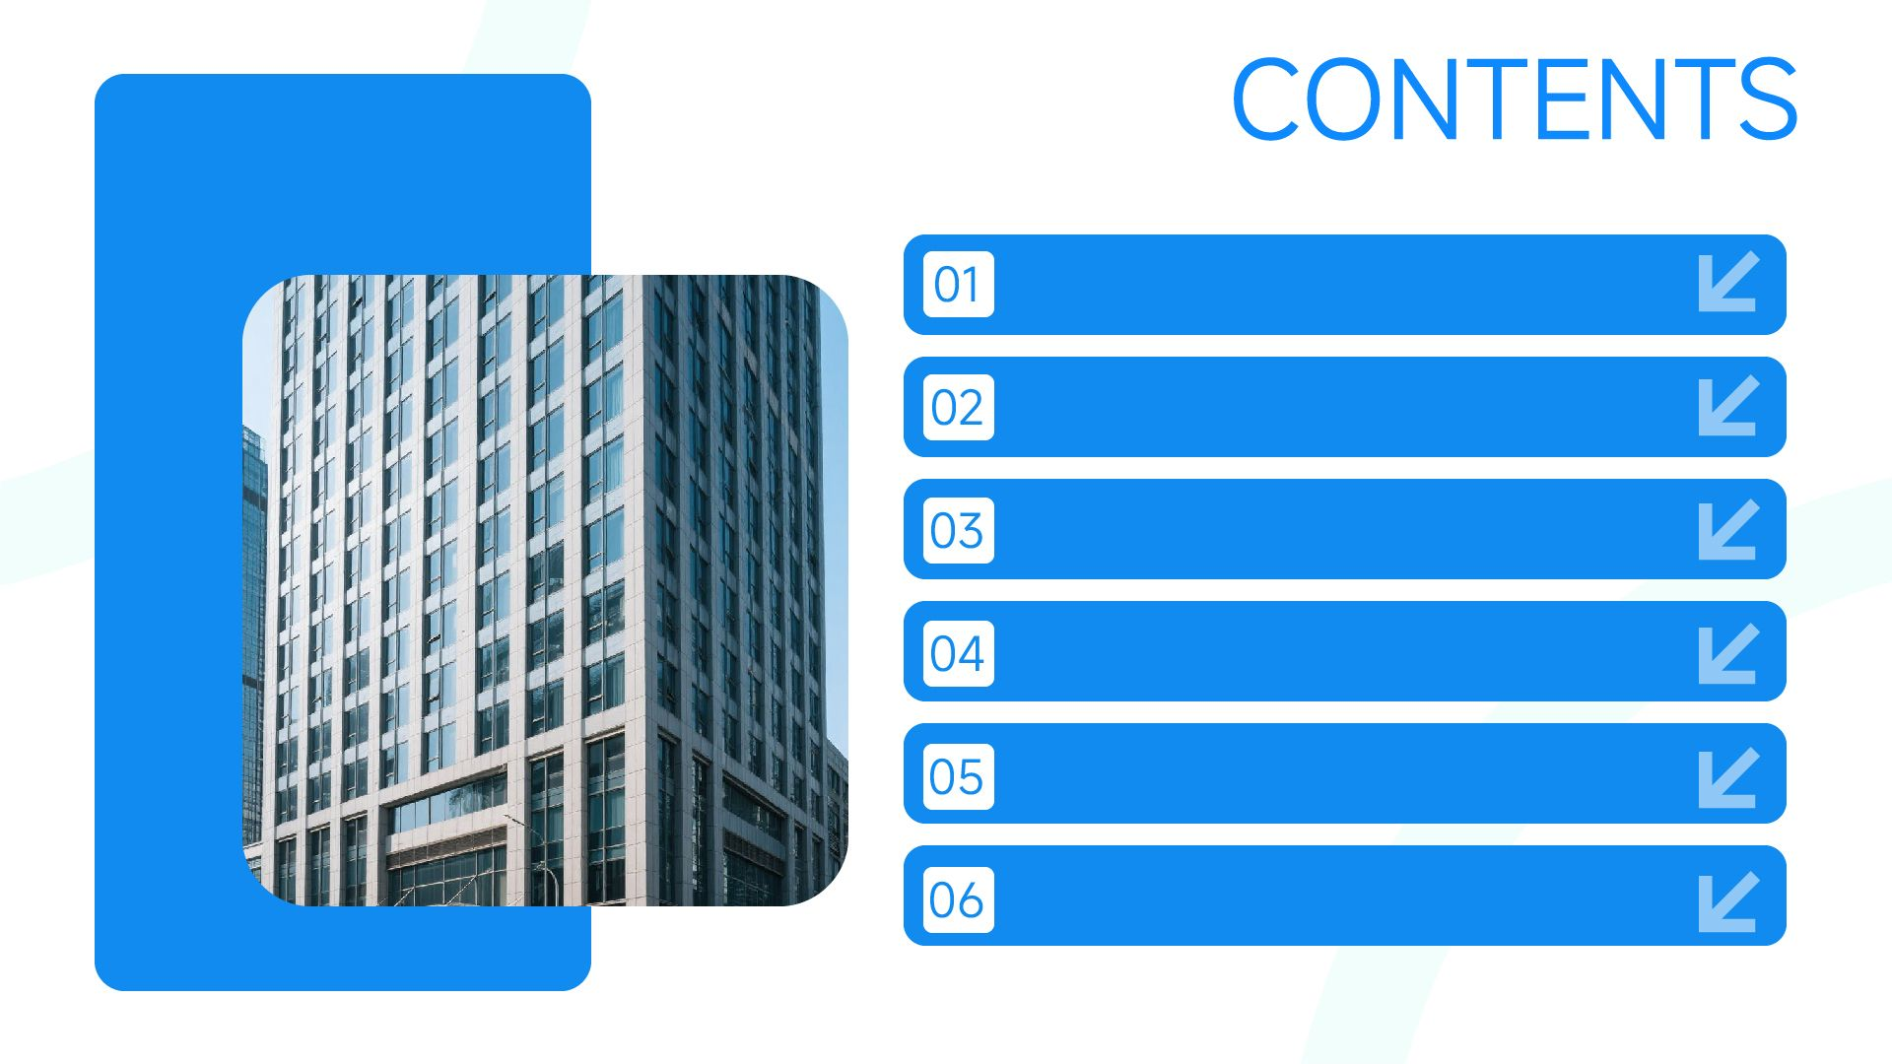
AI Suitability Lens
Signal & Backtest AI
Risk & Sentiment AI
Execution & Reporting
Human Edge
Action Plan

Slide 3

01
AI Suitability Lens

Slide 4

Decide When AI Adds Alpha
Five-Criteria Filter
High Scores Unlock Gains
Human Veto Essential
Flagging Human-Intensive Tasks
Use repetition, pattern density, data volume, error risk, and urgency to score trading tasks for AI readiness. High scores indicate tasks where AI can significantly enhance efficiency and accuracy.
Tasks with high scores across signal detection, backtesting, execution, and risk management are prime candidates for AI automation, ensuring genuine speed and accuracy improvements.
Despite AI's capabilities, human oversight remains crucial for model governance, ethical judgment, and strategic decision-making, ensuring that AI outputs align with market realities and ethical standards.
Low-scoring tasks highlight areas where human expertise is irreplaceable, such as discretionary trades, ethical considerations, and complex market interpretations.

Slide 5
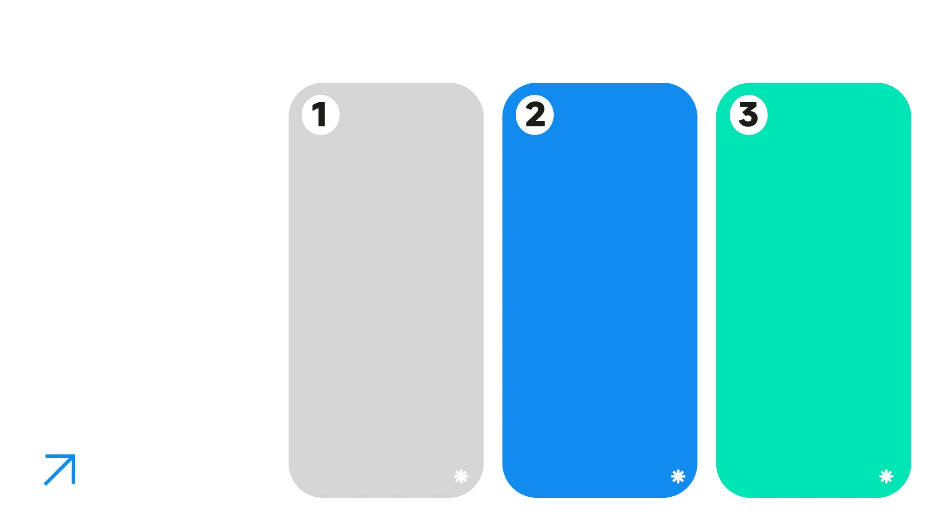
High-Potential Task Showcase
Market Analysis
Strategy Backtesting
Trade Automation
AI excels at analyzing vast datasets to identify emerging market trends, technical signals, and price correlations, providing traders with actionable insights in real time.
AI-powered backtesting tools allow traders to test and optimize strategies across multiple market conditions, accelerating the refinement process and improving performance.
Automated trading systems, enhanced by AI, execute trades with minimal slippage and market impact, ensuring precision and discipline in high-frequency trading environments.

Slide 6
02
Signal & Backtest AI

Slide 7

Ingesting Market Data
TradingView AI, Koyfin, and Bloomberg Terminal AI ingest price, technical, and sentiment data to flag breakouts, divergences, and correlations in real time, significantly reducing research time.
Market Signal Generation
Trader Validation Required
While AI can generate signals, trader validation is essential before deploying capital to ensure alignment with market context and strategic objectives.

Slide 8

Strategy Backtesting Engines
Automated Testing
Out-of-Sample Verification
QuantConnect, MetaTrader AI plugins, and Backtrader-plus-ML offer automated walk-forward tests, parameter optimization, and Monte Carlo stress runs to refine trading strategies.
Traders must verify backtested strategies using out-of-sample data to ensure robustness and avoid overfitting, maintaining a balance between AI and human judgment.
Speed and Efficiency
Regime-Shift Awareness
AI accelerates the backtesting process, allowing traders to quickly evaluate and optimize strategies across various market conditions.
AI models need continuous monitoring and adjustment to adapt to changing market regimes, ensuring that strategies remain effective and relevant.

Slide 9
03
Risk & Sentiment AI

Slide 10

Real-Time Risk Management
Dynamic VaR and Correlation Shocks
Optimal Hedge Sizing
Human Sign-Off Required
BlackRock Aladdin and Riskfolio provide dynamic Value at Risk (VaR) calculations and correlation analysis to protect capital during market volatility spikes.
AI-driven tools optimize hedge sizing to minimize risk exposure, ensuring that portfolios are well-protected against adverse market movements.
Traders must approve tail-risk assumptions and mandate compliance before rebalancing portfolios, maintaining control over critical risk management decisions.

Slide 11

Real-Time Sentiment Analysis
Contextual Confirmation
Bloomberg AI, Accern, and Dataminr analyze breaking news, social media, and filings to score sentiment and event impact within seconds, providing traders with actionable insights.
Traders must confirm AI-generated insights with fundamental context to avoid noise trades and ensure that sentiment analysis aligns with broader market trends.
News & Sentiment Parsing

Slide 12
04
Execution & Reporting

Slide 13

Automated Trade Execution
Order Routing and Slicing
MetaTrader Expert Advisors, Interactive Brokers AI, and Alpaca API-plus-ML route, slice, and time orders to minimize slippage and market impact, ensuring precise trade execution.

Slide 14
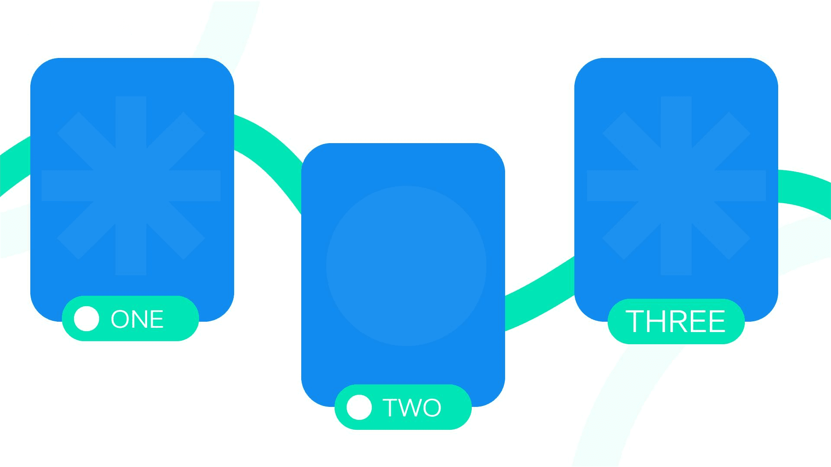
AI-Enhanced Reporting Suites
Automated Dashboards
Human Review Essential
Excel Copilot, Tableau plus AI, and Power BI plus AI generate P&L, risk-adjusted returns, and portfolio attribution dashboards, saving time and improving reporting efficiency.
Traders must review AI-generated reports to ensure accuracy, format compliance, and narrative coherence before sharing with investors.
Natural-Language Queries
Traders can use natural-language queries to extract specific insights from AI-enhanced dashboards, ensuring quick access to critical information.

Slide 15
05
Human Edge

Slide 16

Strategic Intuition
Traders' strategic intuition, ethical judgment, and ability to interpret market regimes remain crucial strengths that AI cannot replicate.
Where Traders Still Win
Client Rapport
Building and maintaining client relationships requires human empathy and personalized communication, ensuring trust and long-term partnerships.

Slide 17

Objective Definition
Signal Generation and Testing
Traders define trading objectives and risk budgets, ensuring that AI models align with strategic goals and market conditions.
AI generates trading signals and conducts backtesting, providing data-driven insights for strategy refinement.
Partnership Workflow Loop
Traders validate and calibrate AI-generated signals, ensuring accuracy and relevance before deployment.
Traders continuously monitor AI performance, refine models, and ensure compliance with regulatory standards.
Validation and Calibration
Continuous Governance

Slide 18
06
Action Plan

Slide 19

Tool Selection
List each trading task alongside its top AI engine, primary benefit, and critical human checkpoint. Use this reference to make rapid tool choices under market pressure.
One-Page Tool Selector

Slide 20

Next-Step Deployment Sprint
14-Day Sprint
Continuous Improvement
Audit current workflow against the matrix, pilot one high-impact AI tool on a paper-trading book, measure speed and error delta, document lessons, refine limits, and scale gradually.
Start small, log everything, and iterate to build trust and sustainable alpha. Continuous monitoring and refinement are key to successful AI integration.

Slide 21

2025/08/05
Sean Wong

